Slide 1
Customer Shopping Trends
Contributors: Kashish Jain Charu Arora
Anoje Janathanan
Marieri Okeme

Slide 2
Introduction
This project offers insight and patterns in relation to understanding consumer preferences based on their spending habits/purchase patterns. Furthermore, the dataset itself showcases different attributes of a customer such as age, gender, purchase history, frequency of purchases, etc.
These characteristics are used to analyze relationships to shopping trends. We seek answer the following research questions:
In what way(s) does shopping frequency vary by season according to gender.
What seasonal trends or patterns can be identified in relation to consumer spending habits.
What is the relation/commonality between the location and the categories purchased.
What are the trending product categories for specific age groups

Slide 3
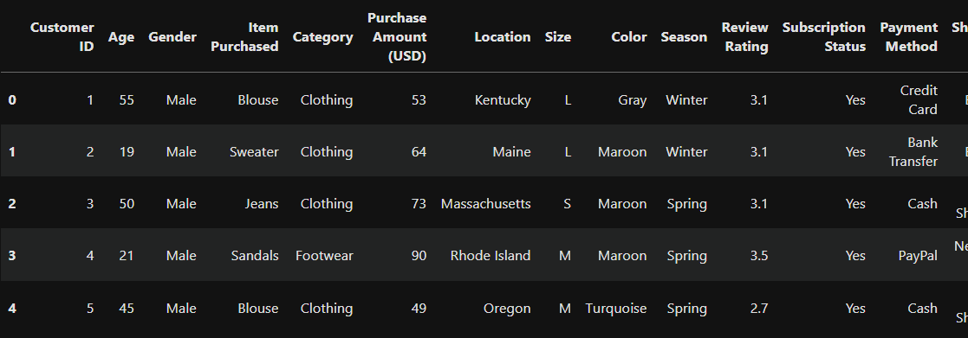
Data Overview

Slide 4
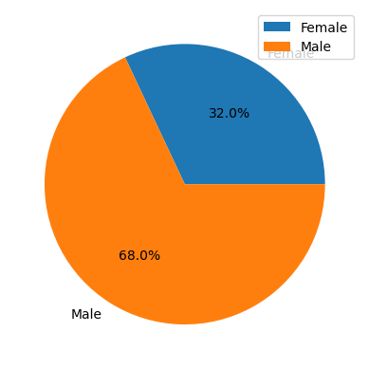
In what way(s) does shopping frequency vary by season according to gender.

Slide 5
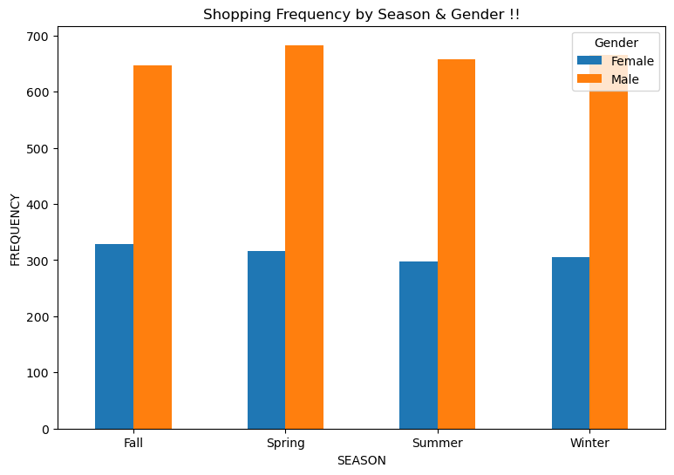
In what way(s) does shopping frequency vary by season according to gender.

Slide 6
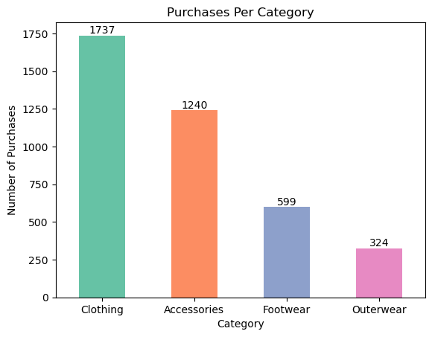
What seasonal trends or patterns can be identified in relation to consumer spending habits.

Slide 7
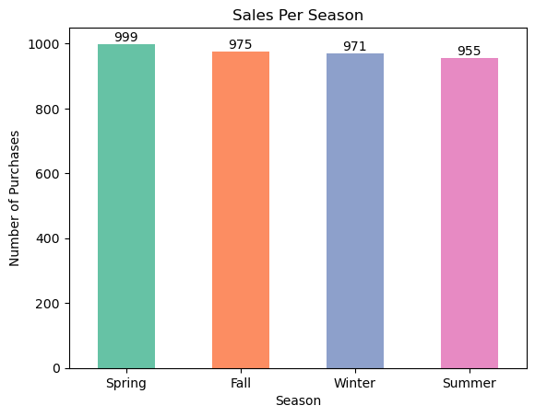
What seasonal trends or patterns can be identified in relation to consumer spending habits.

Slide 8
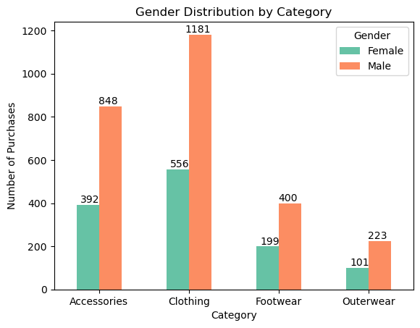
What seasonal trends or patterns can be identified in relation to consumer spending habits.

Slide 9
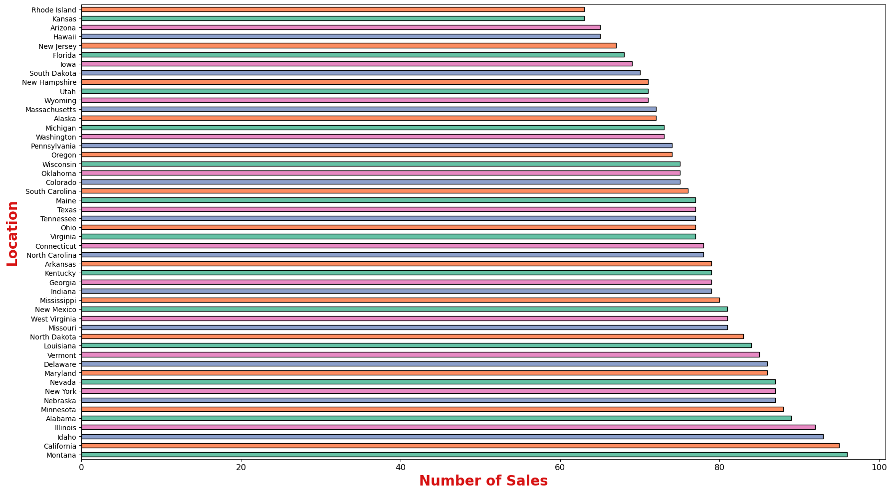
What is the relation/commonality between the location and the categories purchased

Slide 10
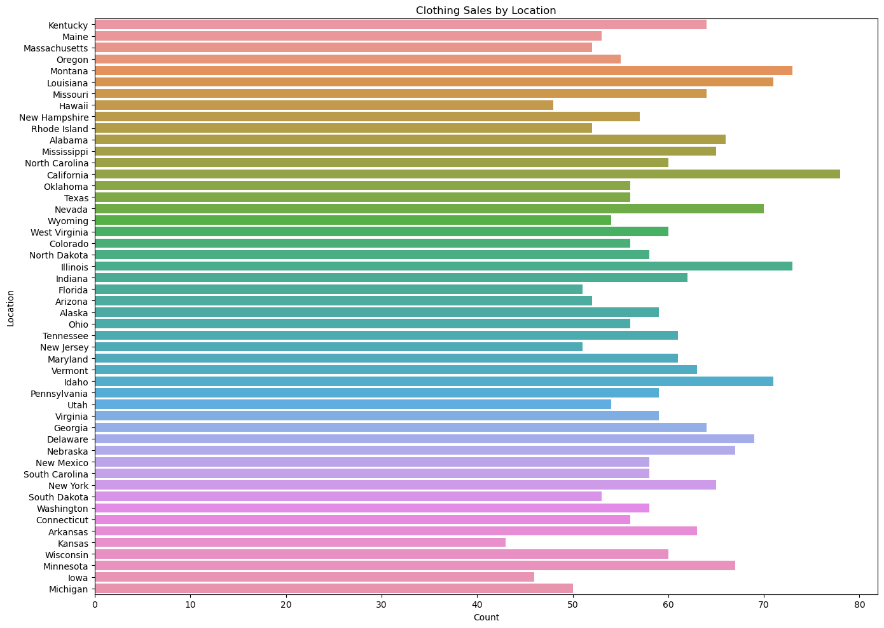
What is the relation/commonality between the location and the categories purchased

Slide 11
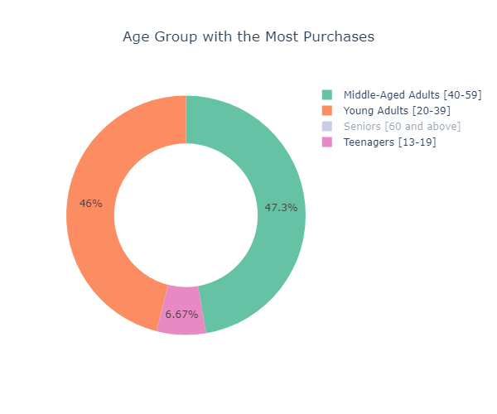
What are the trending product categories for specific age groups

Slide 12
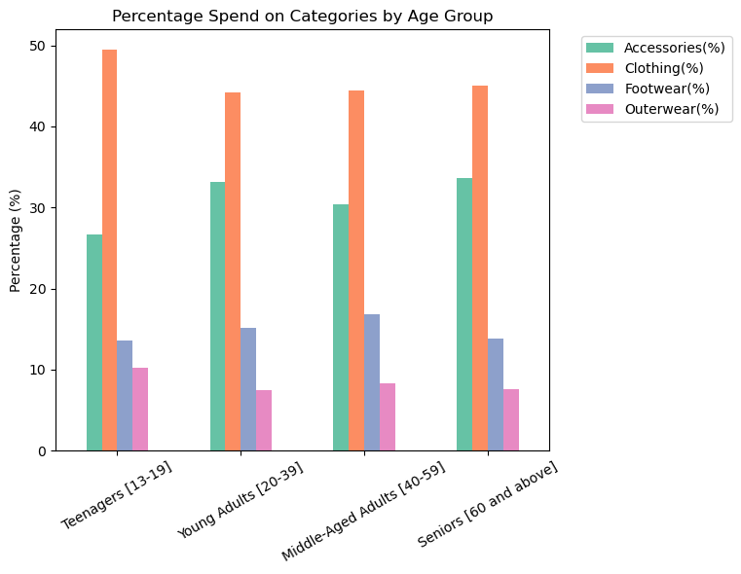
What are the trending product categories for specific age groups

Slide 13
Insights
From the analysis we can see that males purchase more frequently across all seasons. One inference that can be made is that males are more inclined to shop on a more frequent basis for specific items, where as females go for less frequent, but larger shopping journeys.
Sales are consistent all year regardless of the season
Clothing has the highest number of sales in every location with California having the most in sales and Montana having the overall highest sales. This goes in line with the fact that it is the most popular category across all age groups.

Slide 14
THANK YOU!

